Slide 1
Want to learn how other dealers attract customers?

Slide 2

Read their email.

Slide 3

Read their email.

Slide 4
Are you on target?

Slide 5
Are you on target?

Slide 6






In-depth analysis gives you the edge.

Slide 7
In-depth analysis gives you the edge.

Slide 8
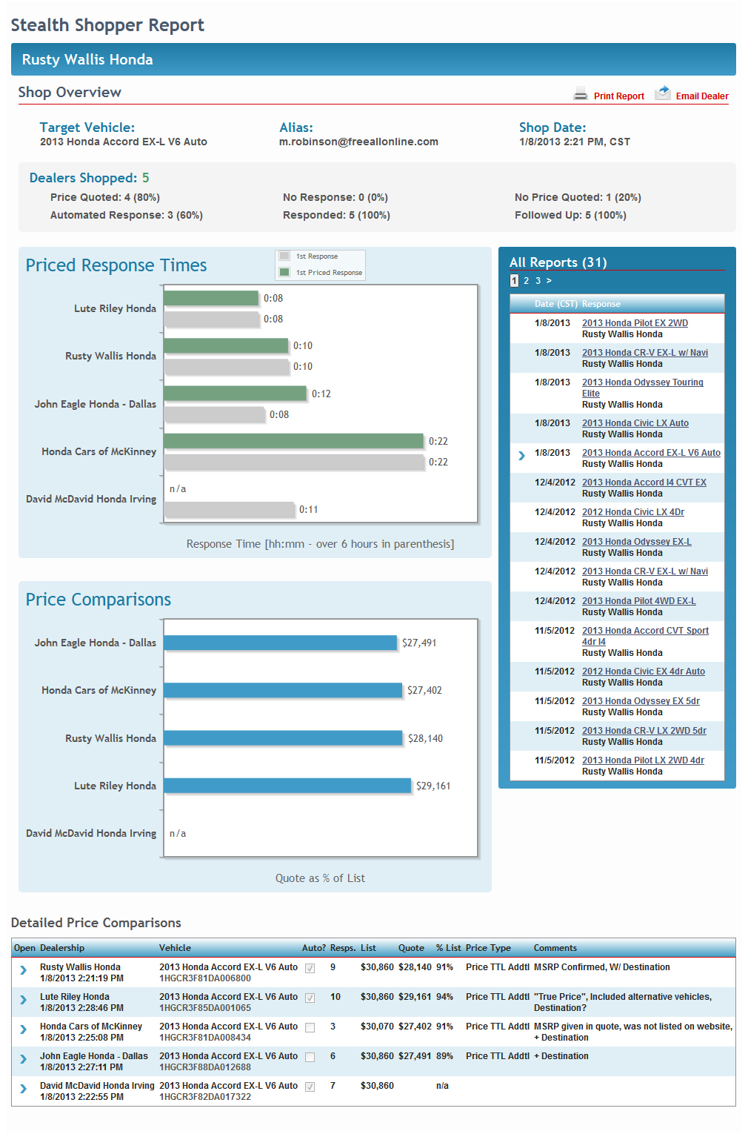

In-depth analysis gives you the edge.

Slide 9
In-depth analysis gives you the edge.
See an overview of all your shops.

Slide 10
In-depth analysis gives you the edge.
Compare priced and non-priced response times.

Slide 11
In-depth analysis gives you the edge.
Compare price quotes.

Slide 12
In-depth analysis gives you the edge.
Access all archived emails.

Slide 13
In-depth analysis gives you the edge.
View detailed price comparisons.

Slide 14

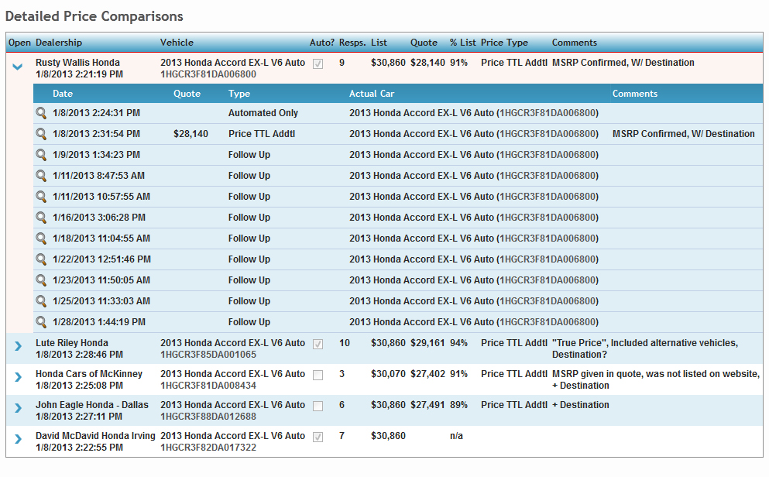
Read every email they send.

Slide 15
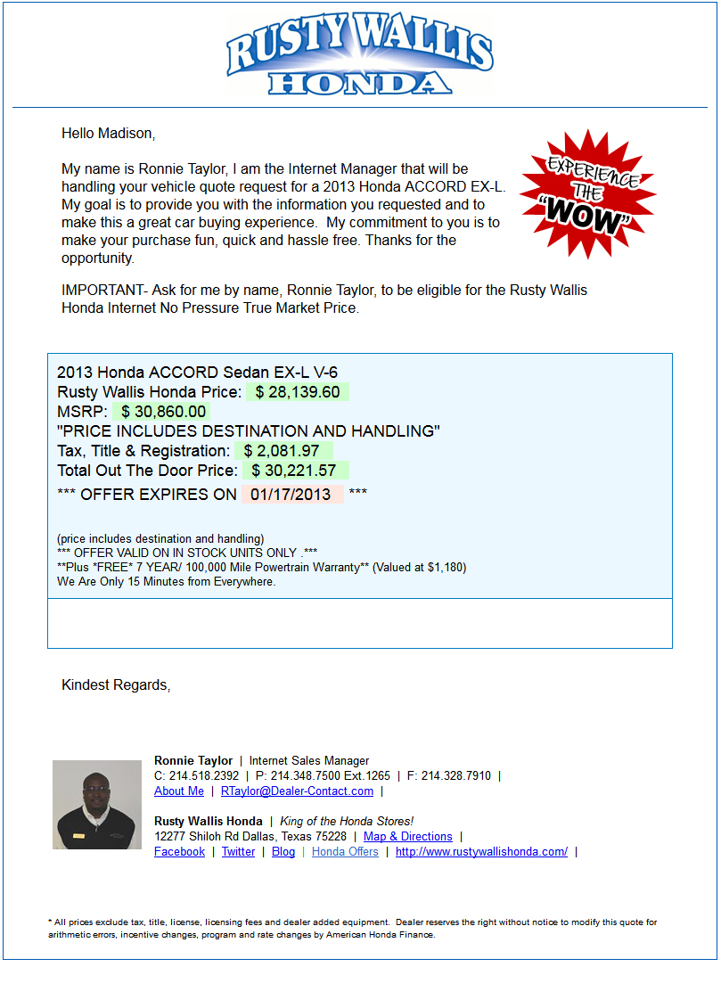
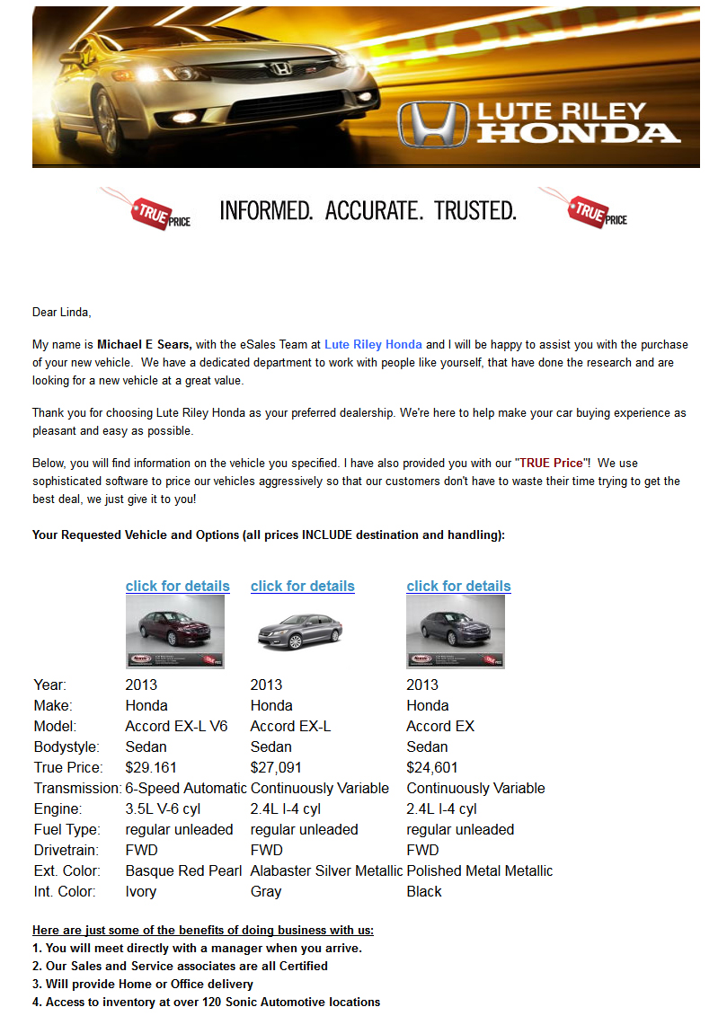
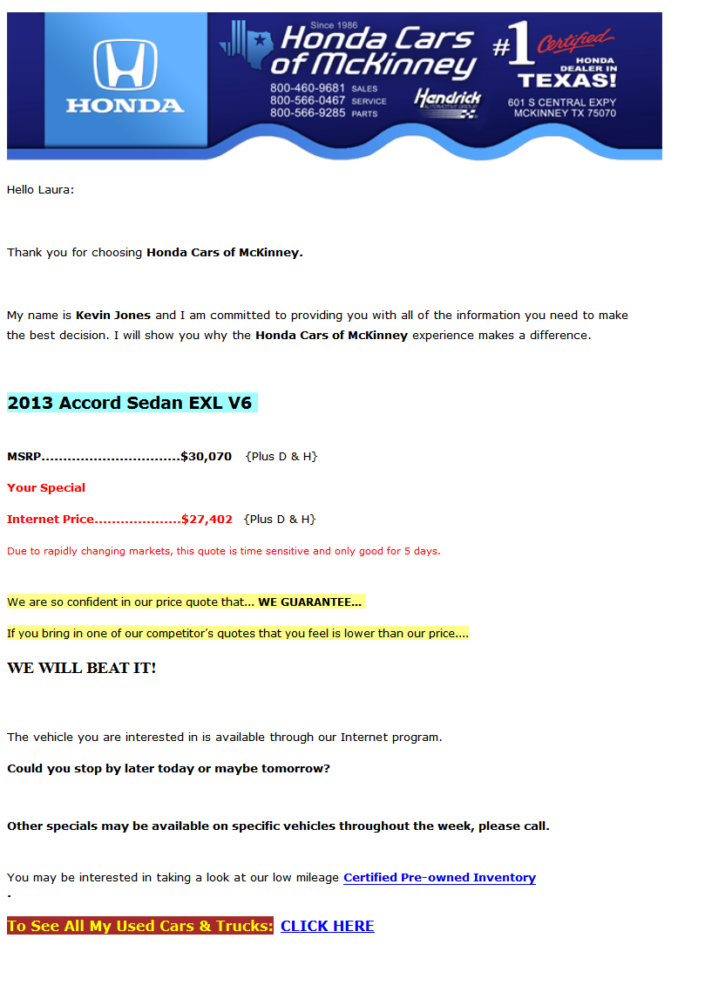
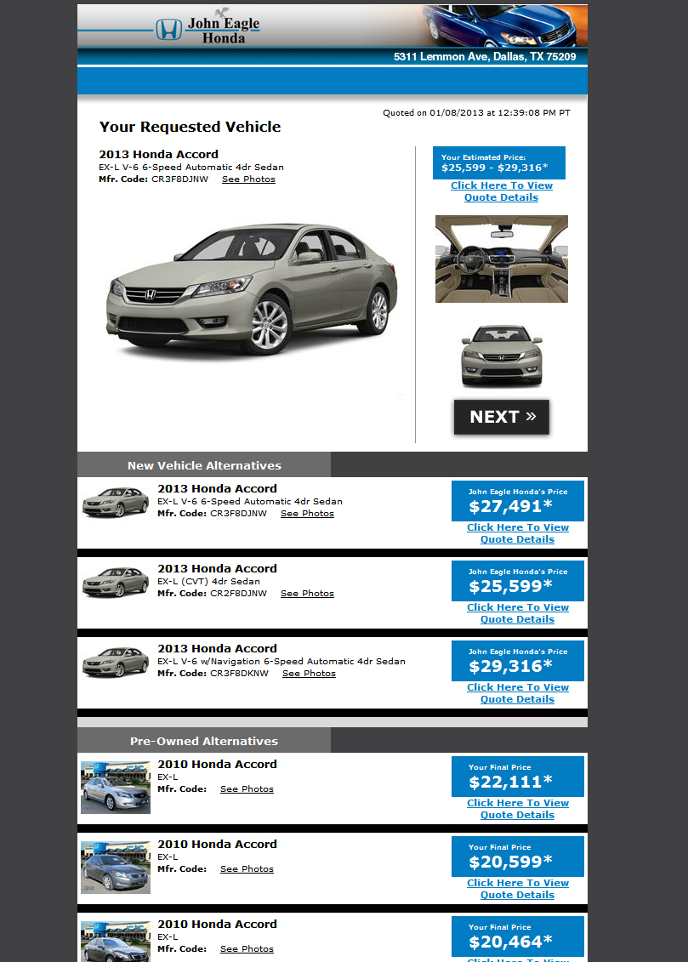
Read every email they send.

Slide 16

Your success hinges on your ability to research the marketplace.

Slide 17
Are you on target?

Slide 18
Are you on target?

