Slide 1


Boutique Dealer Websites
by

Slide 2
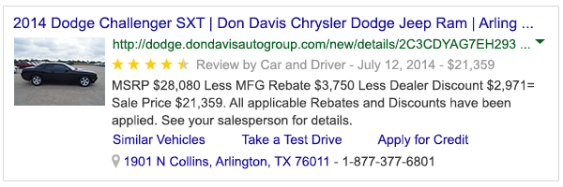
Rich Snippet Search Results
Boutique Dealer Websites

Slide 3
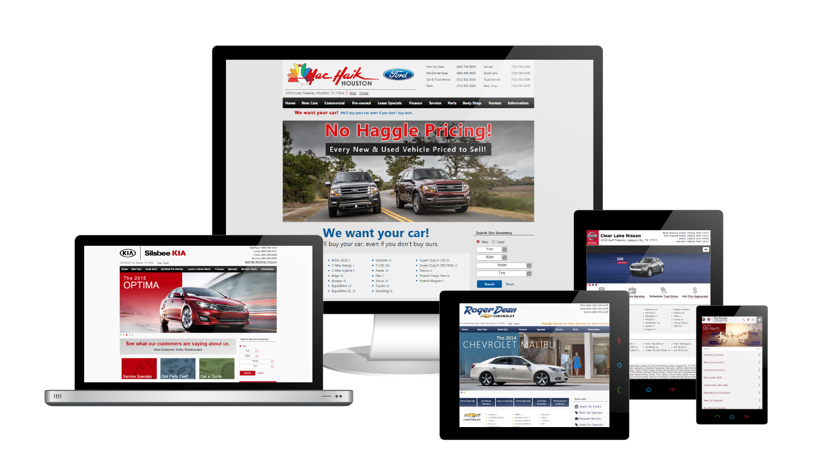
New Responsive Architecture
Boutique Dealer Websites

Slide 4
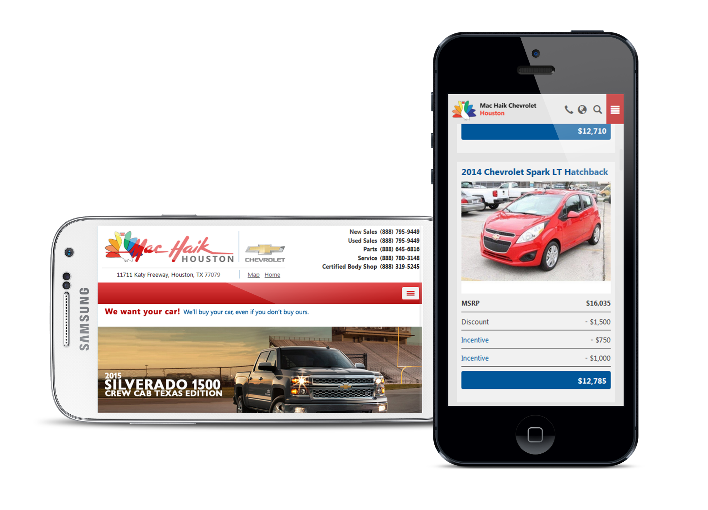
Enhanced Mobile Experience
Boutique Dealer Websites

Slide 5

Concierge Service and Support
Boutique Dealer Websites

Slide 6
Our Custom Shop is at your service.

