Slide 1
May 29, 2015
The Stealth Shopper Approach:
Driving Force Dealer Mystery Shopping Services, presented to TOYOTA MOTOR SALES, U.S.A.

Slide 2

Overview: Why Driving Force?
“Driving Force has developed the finest outsourced digital mystery shopping platform for car dealers.”
- Automotive Website Awards, January 23, 2015

Slide 3
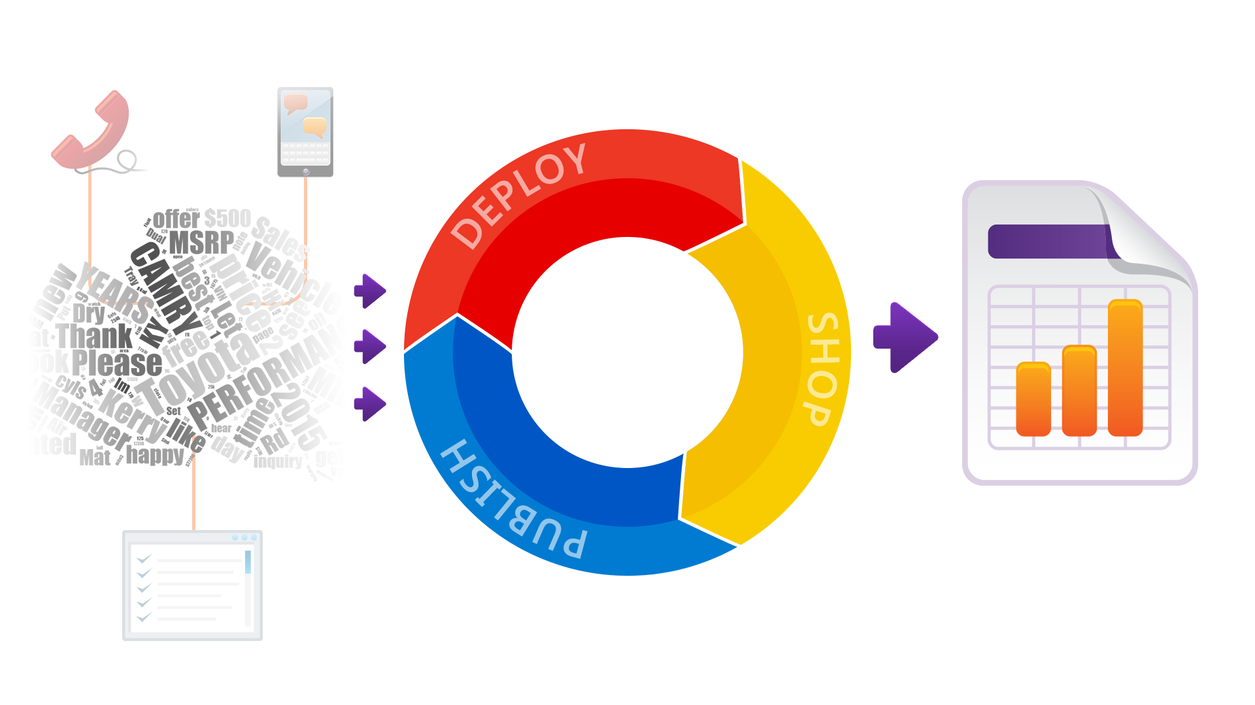
System Design: Stealth Shopper Goal

Slide 4
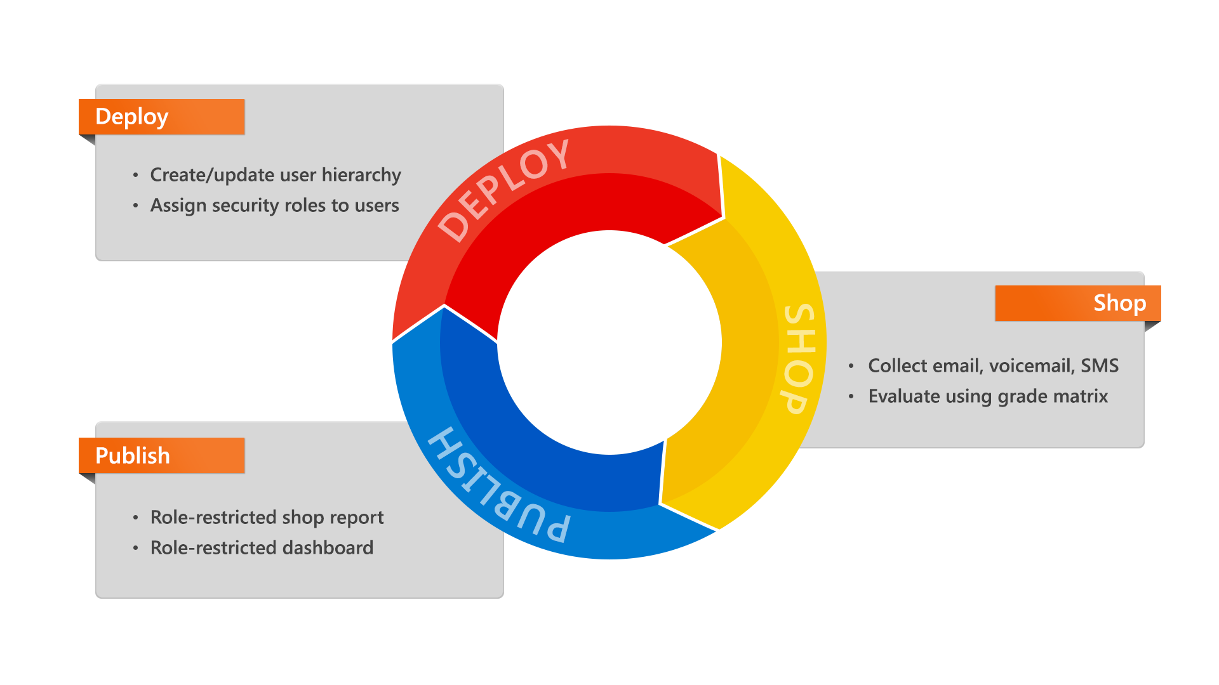
System Design: Stealth Shopper Approach

Slide 5
System Design: Deployment
Hierarchy and Security
Dealership hierarchy
Application Security
  Role-based security
  Record-level security

Slide 6
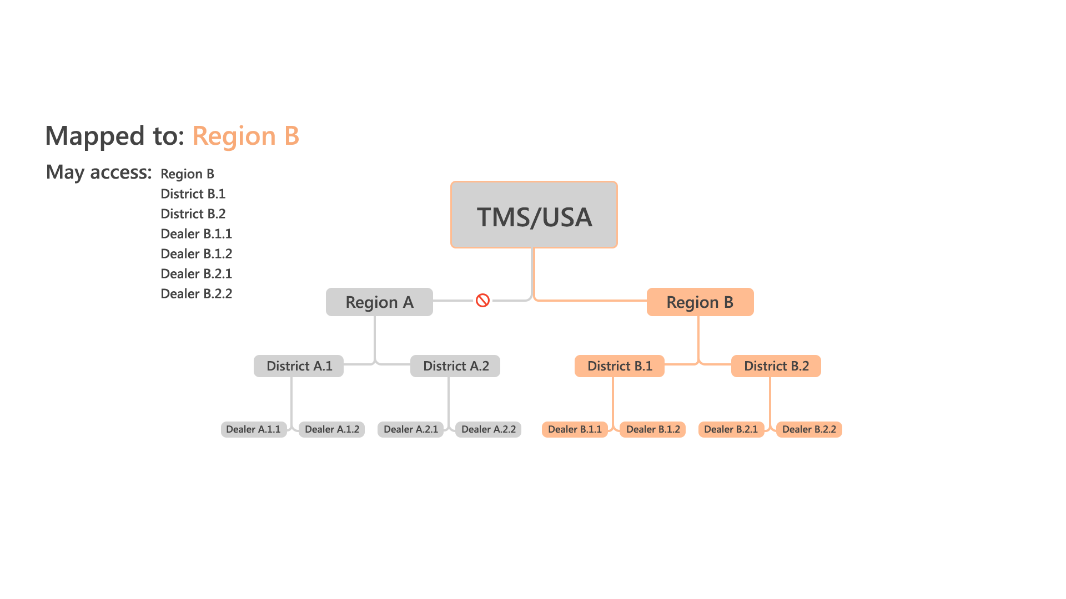
System Design: Deployment

Slide 7
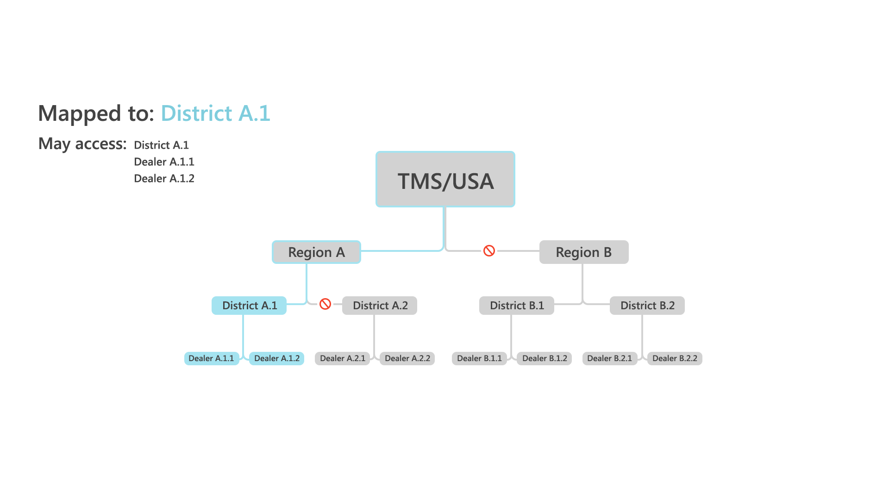
System Design: Deployment

Slide 8
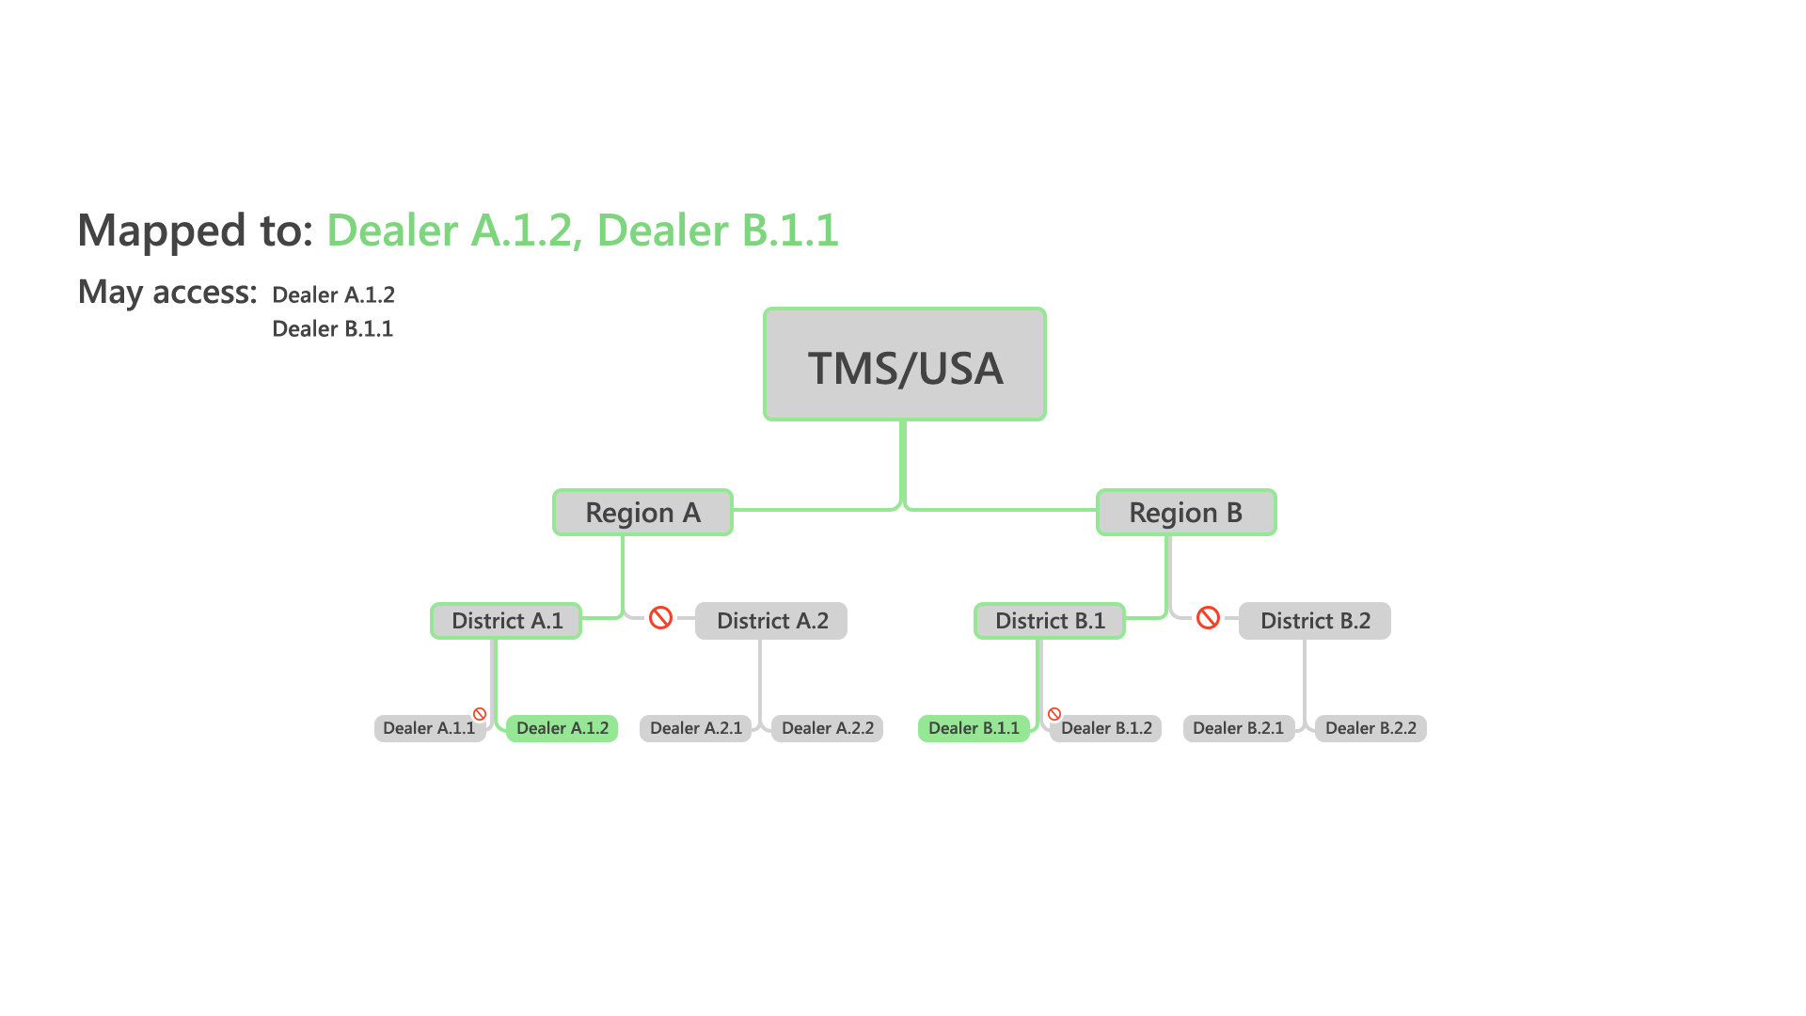
System Design: Deployment

Slide 9
System Design: Deployment
Batch Utility
Automatically create hierarchy of dealerships
  Will run prior to project launch and prior to each round of shops thereafter
  Syncs ELMS and Stealth Shopper dealership and user data
Though the updates will be automated, manual updates will be supported

Slide 10
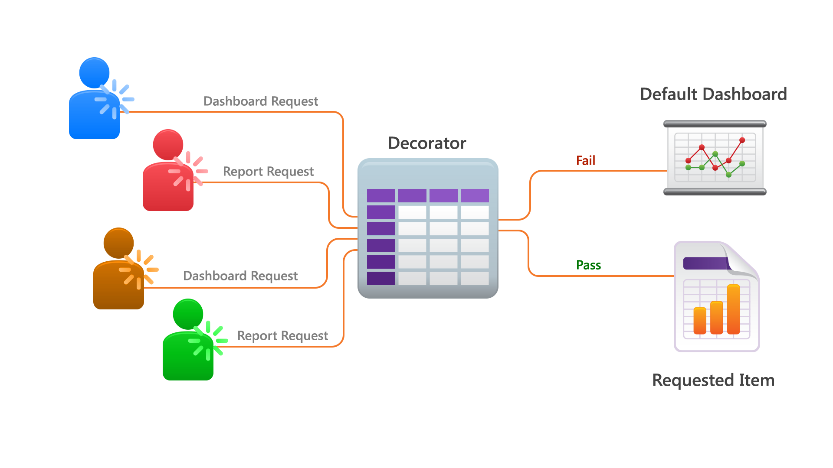
System Design: Deployment
Security Decorator

Slide 11
System Design: Deployment
Metrics
Automatic vs. manual data points
Single value derived from data points on all responses to a given shop
Metrics are configurable

Slide 12
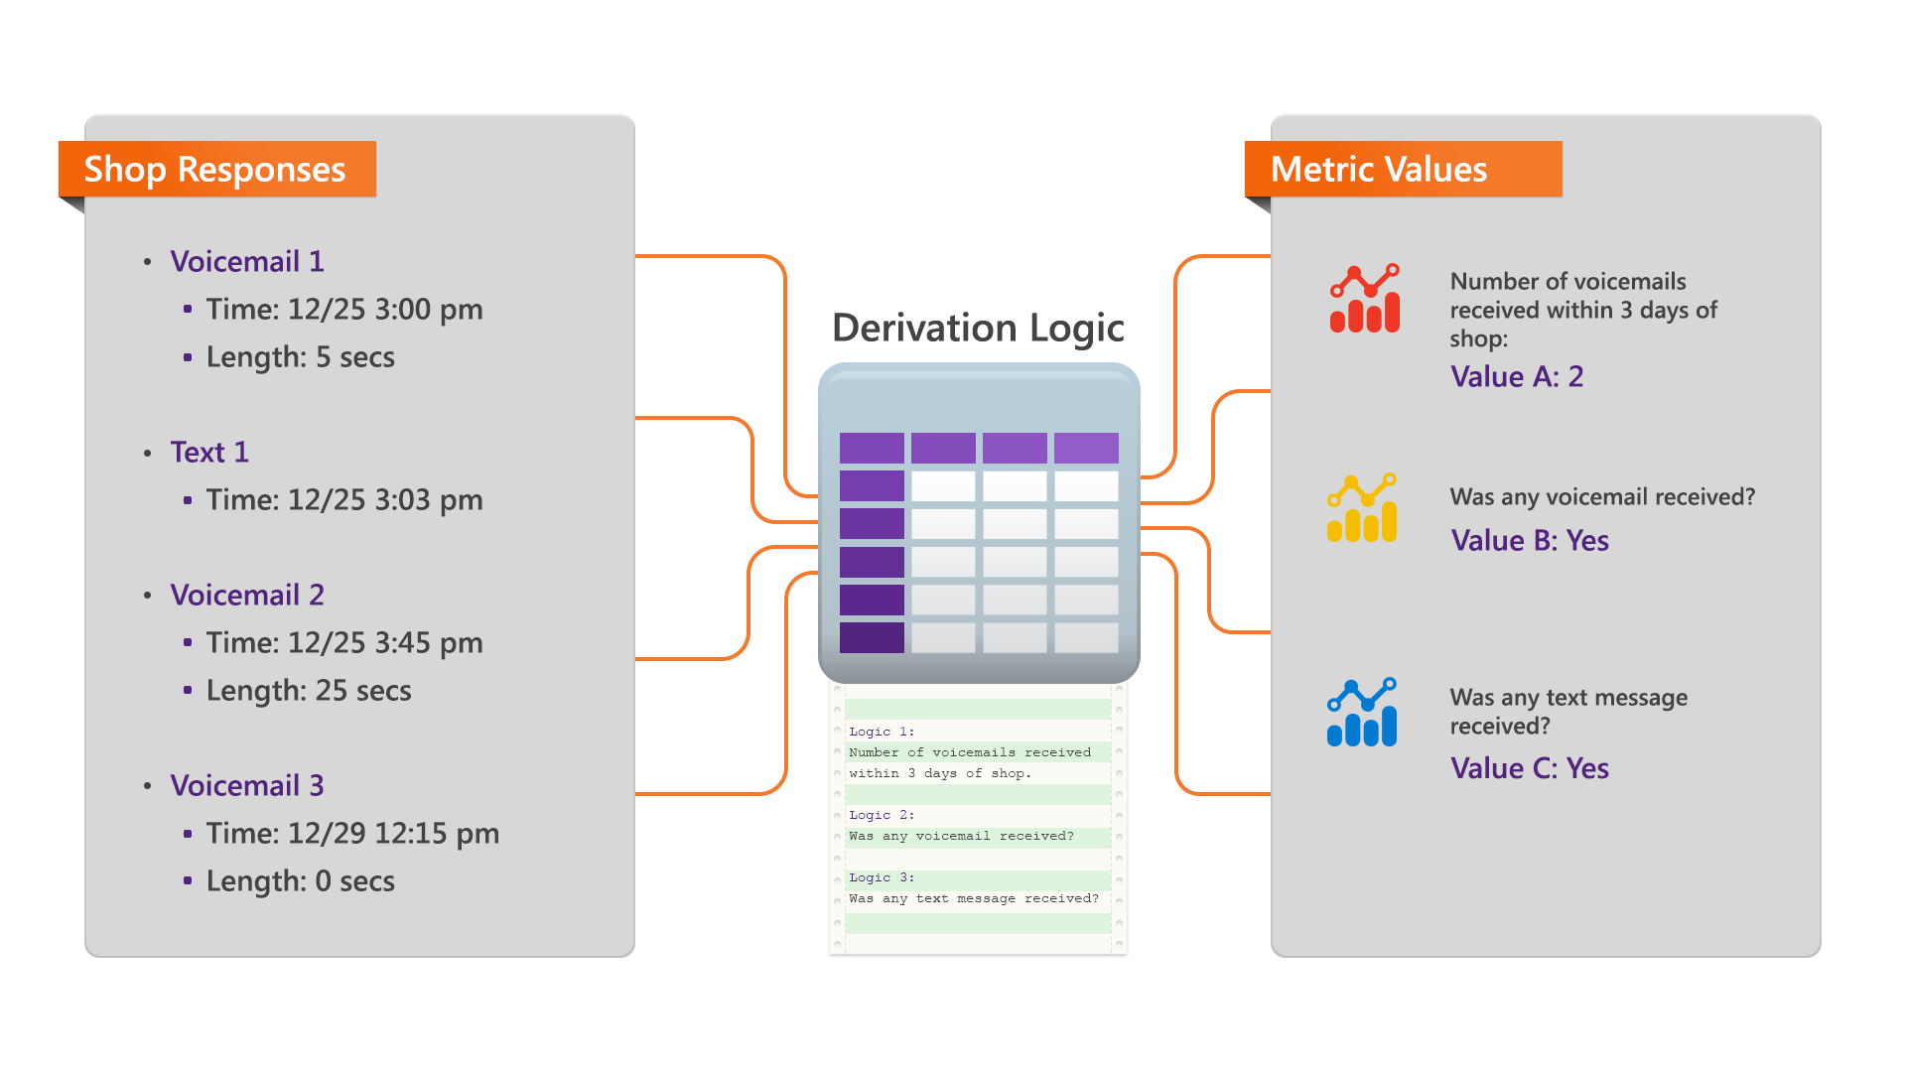
System Design: Deployment

Slide 13
System Design: Deployment
Grading Matrix
Matrix Concept
Metric | Values and Grades
1st price response time | V=<15 min G=30 points | V=>15 & <30 min G=15 points | V=>30 & <60 min G=5 points | V=>60 min G=0 points
Voicemail 1st, then email? | V=Yes G=10 points | V=No G=0 points
Sent manager response? | V=Yes G=10 points | V=No G=0 points
Email and voicemail on 2nd day? | V=Yes G=10 points | V=No G=0 points
1st voicemail time | V=<15 min G=30 points | V=>15 & <30 min G=15 points | V=>30 & <60 min G=5 points | V=>60 min G=0 points
Valid voicemail percentage | V=100% G=20 points | V=<100% & >75% G=15 points | V=<75% & >0% G=10 points | V=0% G=0 points
Vehicle availability mentioned? | V=Yes G=10 points | V=No G=0 points
Condition 01
  Value 01
  …
  Value n
…
Condition n
  Value 01
  …
  Value n

Slide 14
System Design: Shop
Shop Process Overview
Data collection
Evaluation

Slide 15
System Design: Shop
Additional Recommendation: Text Messages
Text messages are more likely to be seen by your customers
Text messages will be read sooner than email

Slide 16
System Design: Shop
Additional Recommendation: Responsive Email Views
Half of all email views occur on mobile devices
Crafting a response process needs to consider mobile form factors

Slide 17
System Design: Publish
Publishing Overview
Shop report
Dashboard

Slide 18
System Design: Publish
Third Party Integration
Direct: reports are viewed within Stealth Shopper back-end by direct login or 3rd party authentication
Frame-in: reports are loaded within a 3rd party system
Web service: reports and dashboard data will be queryable/downloadable in common data exchange formats
  File formats: JSON, XML, CSV
  Allows ELMS provider to remove live lead metrics

Slide 19
System Design: Publish
Training
How-to videos
Documentation
Support

Slide 20
System Design: Publish
Consultation
Contextualize shop results
Ensure integration of shop result data with other data analysis efforts
Provide ideas and recommendations for process improvement
Revise and refine shop criteria

Slide 21
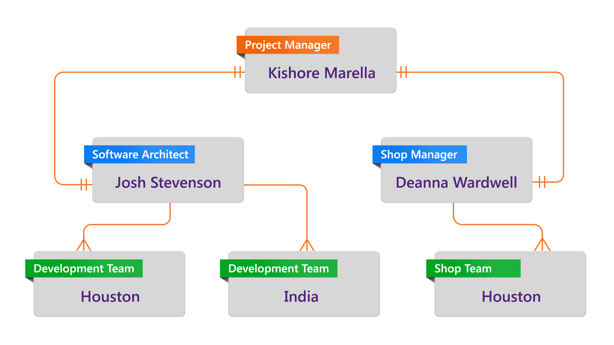
Project Management: Team

Slide 22
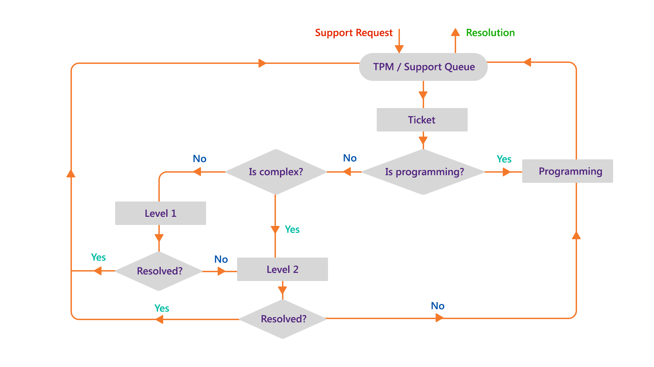
Project Management: Issue Tracking

Slide 23

Project Management: Subcontractors
Subcontractors
InteractiveTel
Litmus Software

Slide 24
Project Management: Test Plan
Test Plan Overview
Methodology
Release
Technical deployment

Slide 25
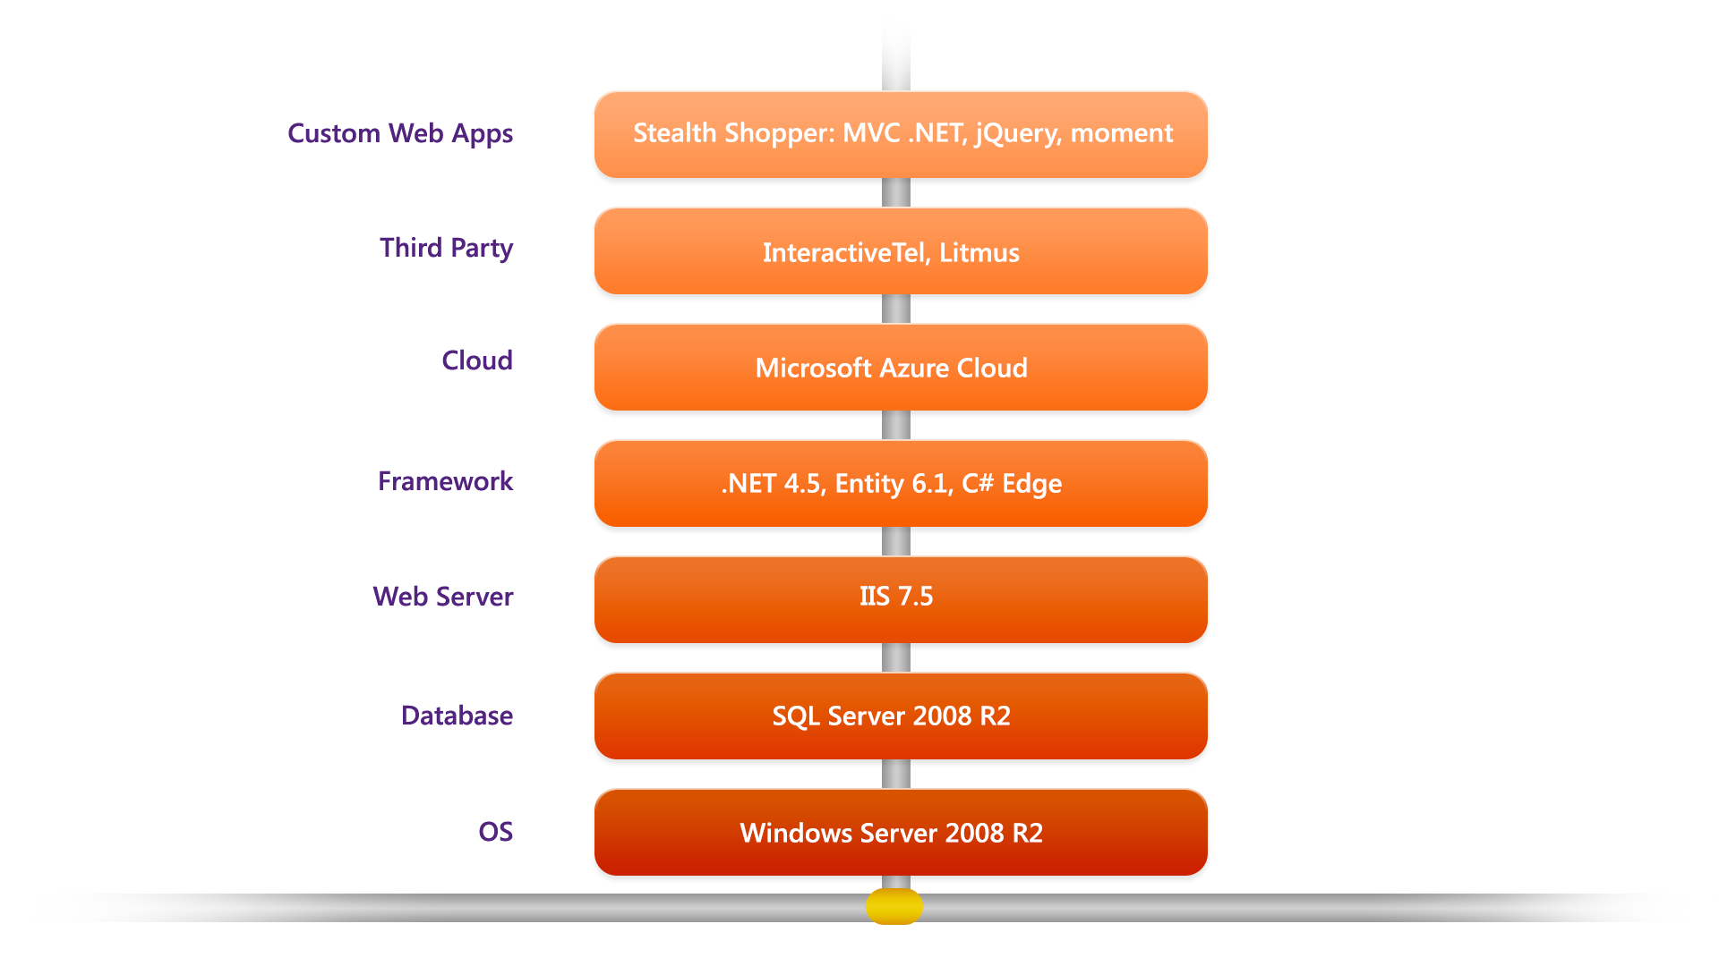
System Information and Reporting UI
Application Stack

Slide 26
System Information
Network Security
Authentication
Database protection
SSL
FTP

Slide 27
System Information
Data Availability
Automatic backups
Database failover strategy
Secondary backups

Slide 28
System Information
Scale
Physical storage: ~10GB
Request bandwidth: 20,000 full-page and 200,000 ajax requests per month

Slide 29
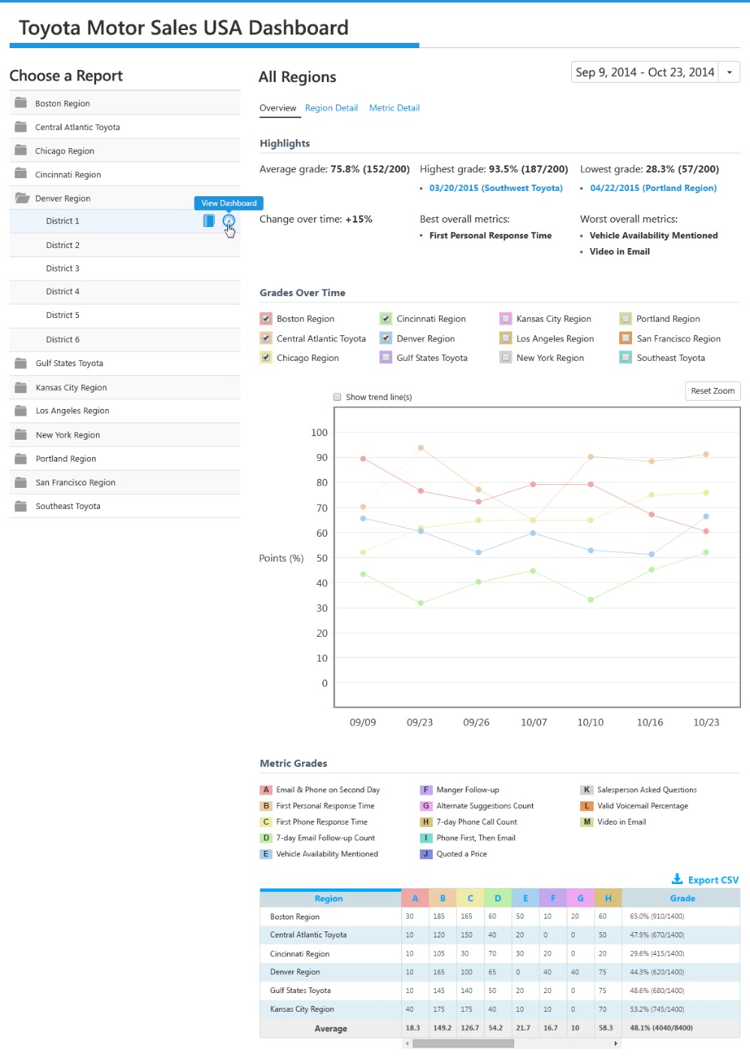
Reporting UI: Dashboard
Overview
Site Map: Navigate to national/ regional/district/dealer dashboard or shop report (as appropriate) based on user permissions
Aggregated scores for selected date range, with highlights
Interactive Graph: Compare regional/ district/dealer grades over time
Interactive Chart: Aggregated metric and final grade totals by region/ district/dealer for selected date range

Slide 30
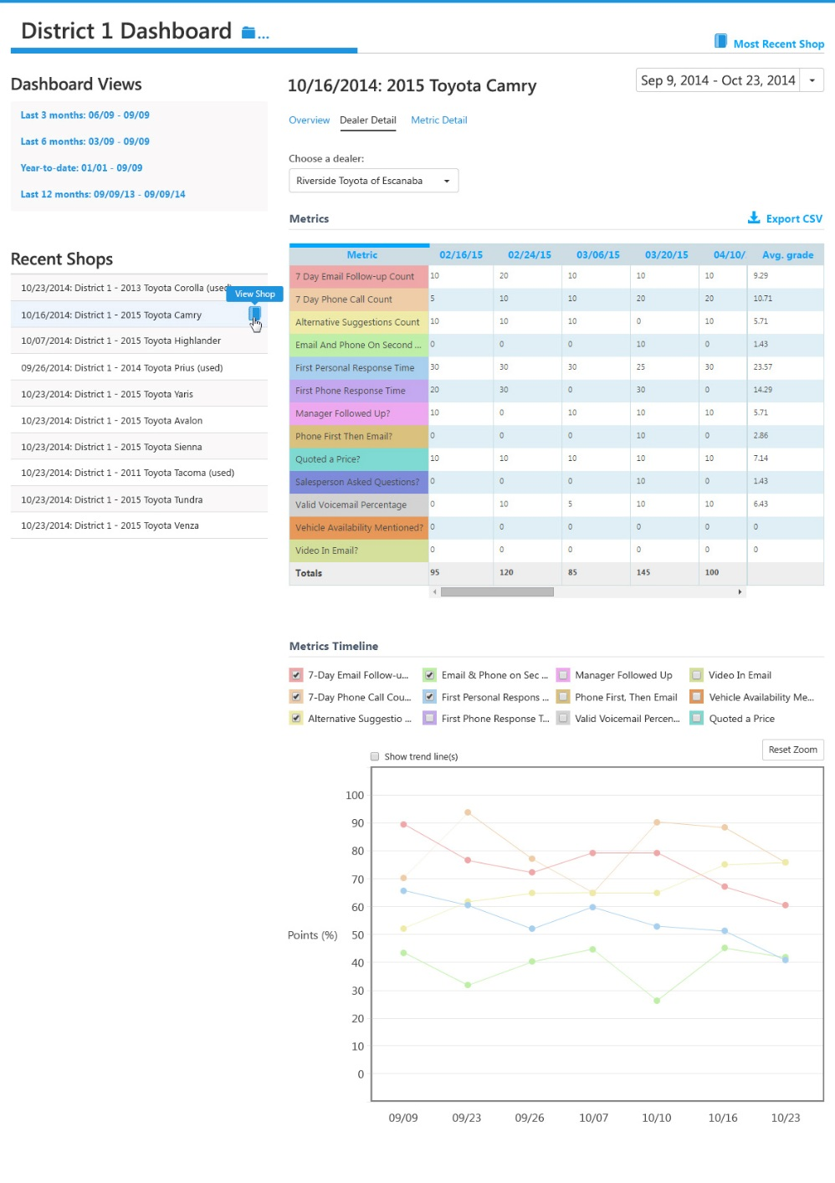
Reporting UI: Dashboard
Hierarchy Detail
Date range selector
Site Map: Navigate to national/ regional/district/dealer dashboard or shop report (as appropriate) based on user permissions
Interactive Chart: Shop metrics for selected region/ district/dealer over time
Interactive Graph: Compare shop metric trends of selected region/ district/dealer over time

Slide 31
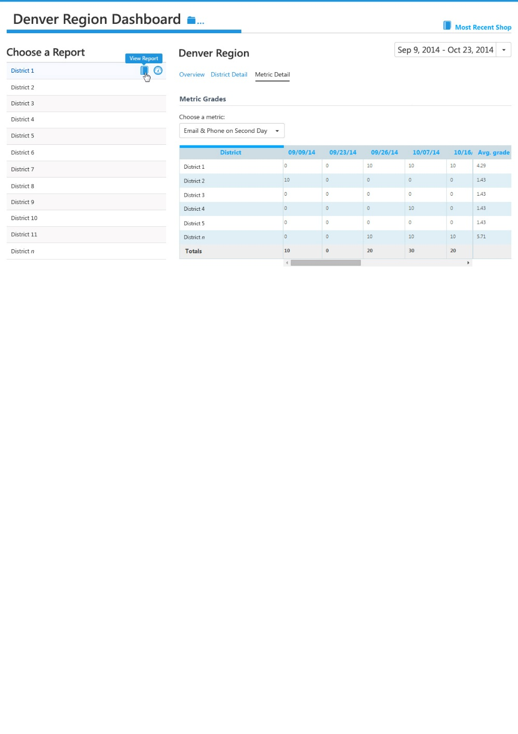
Reporting UI: Dashboard
Metric Detail
Site Map: Navigate to regional/ district/dealer dashboard or shop report (as appropriate) based on user permissions
Interactive Chart: Region/ district/dealer values for selected shop metric over time

Slide 32
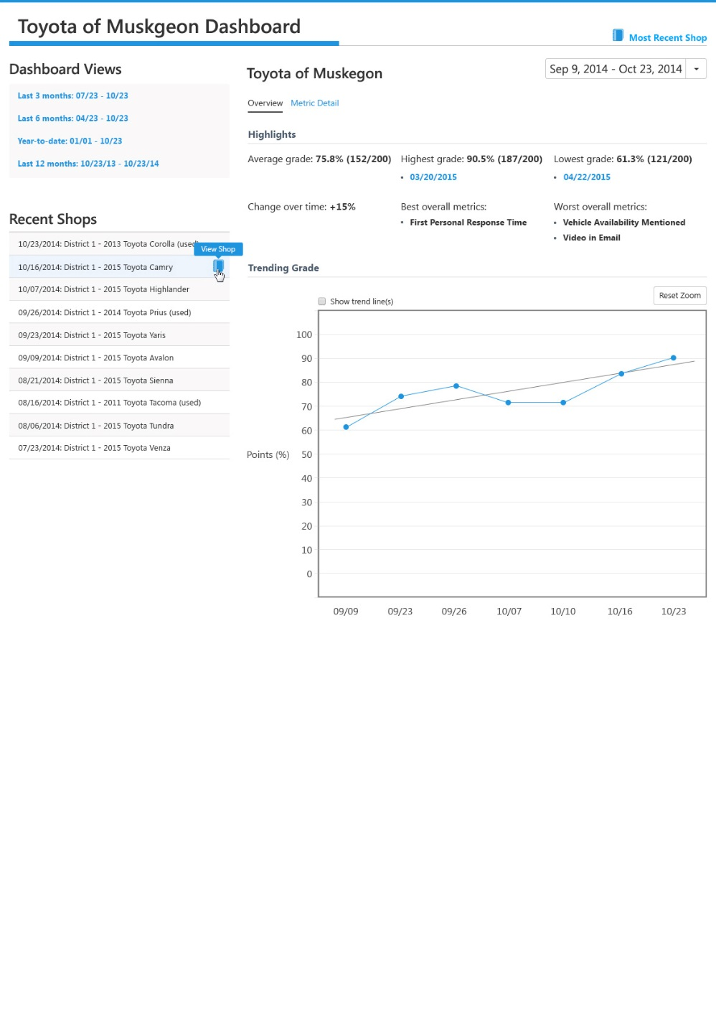
Reporting UI: Dealer Dashboard
Overview
Date range selector
Site Map: Navigate using quick links to historical dashboard data
Aggregated scores for selected date range
Site Map: Navigate using quick links to historical shop reports
Static Graph: View dealer grade over time

Slide 33
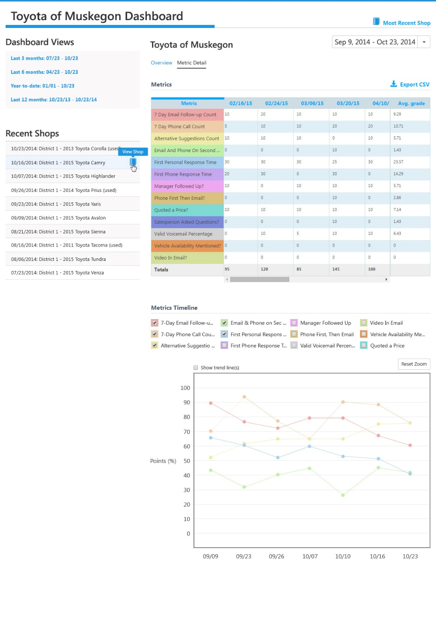
Reporting UI: Dealer Dashboard
Metric Detail
Date range selector
Site Map: Navigate using quick links to historical dashboard data
Static Chart: Metrics table for selected dealer by shop date
Site Map: Navigate using quick links to historical shop reports
Interactive Chart: Compare shop metric trends of dealer over time

Slide 34
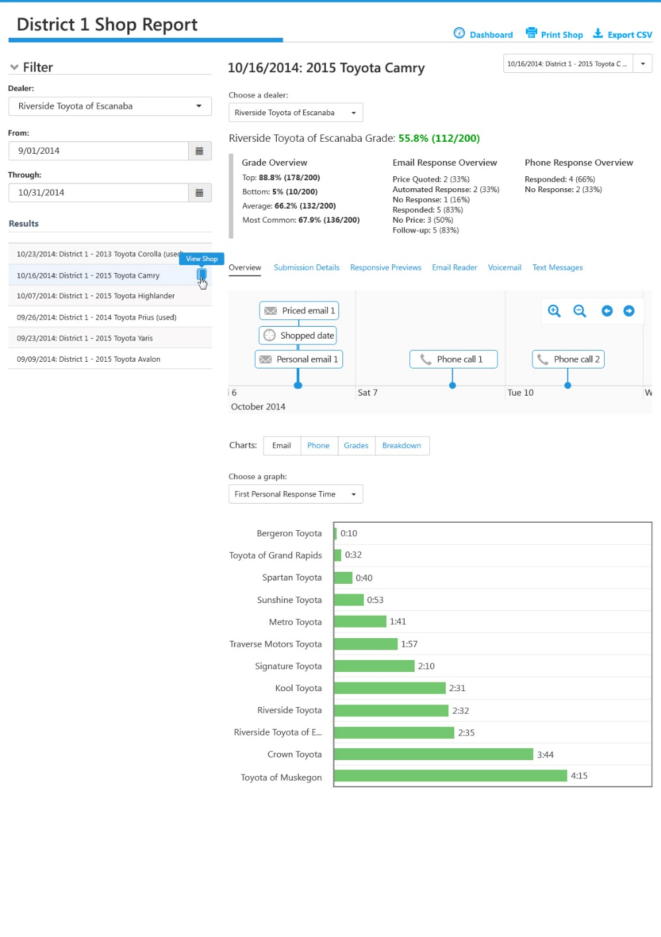
Reporting UI: Shop Report
Overview: Email
Site Map: Searchable shop report history, with search restricted to district-level permissions
Highlights of selected shop
Timeline: Sequence of events plotted on a timeline to reveal the complete follow-up process followed by the dealer
Interactive Chart: Bar chart of dealers in the district and selected email metric

Slide 35
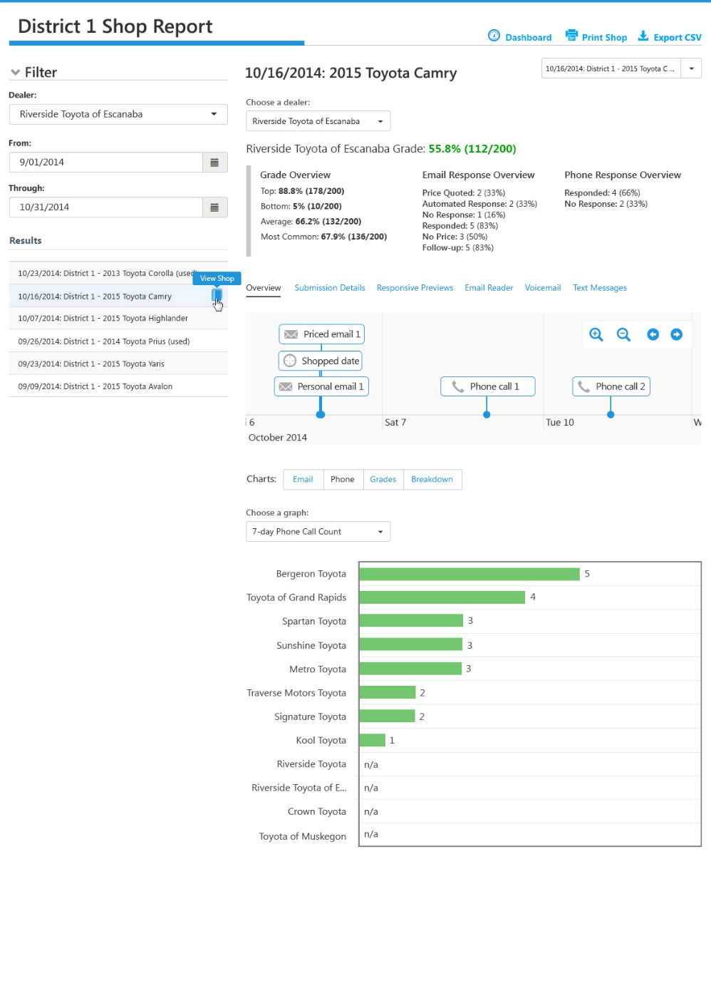
Reporting UI: Shop Report
Overview: Phone
Site Map: Searchable shop report history, with search restricted to district-level permissions
Highlights of selected shop
Timeline: Sequence of events plotted on a timeline to reveal the complete follow-up process followed by the dealer
Interactive Chart: Comparison bar chart of dealers in the district and selected phone metric

Slide 36
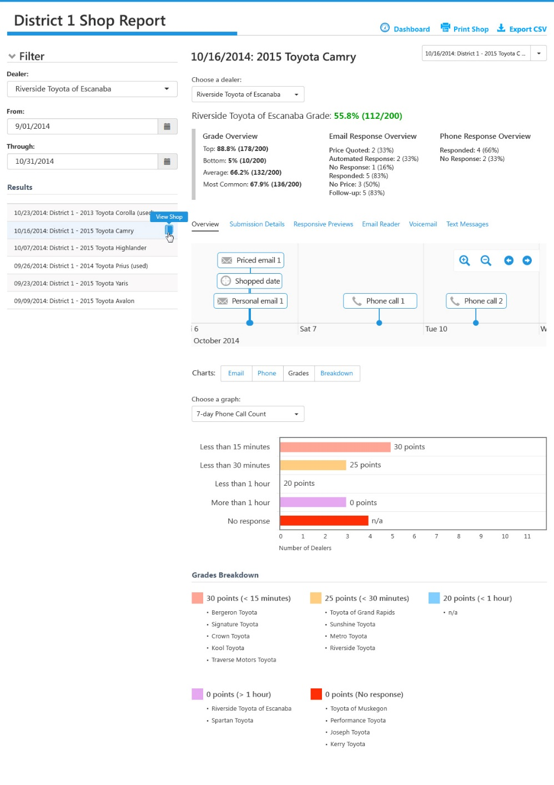
Reporting UI: Shop Report
Overview: Grades
Site Map: Searchable shop report history, with search restricted to district-level permissions
Highlights of selected shop
Timeline: Sequence of events plotted on a timeline to reveal the complete follow-up process followed by the dealer
Interactive Chart: Bar chart of scoring conditions and points received by dealers for the selected metric

Slide 37
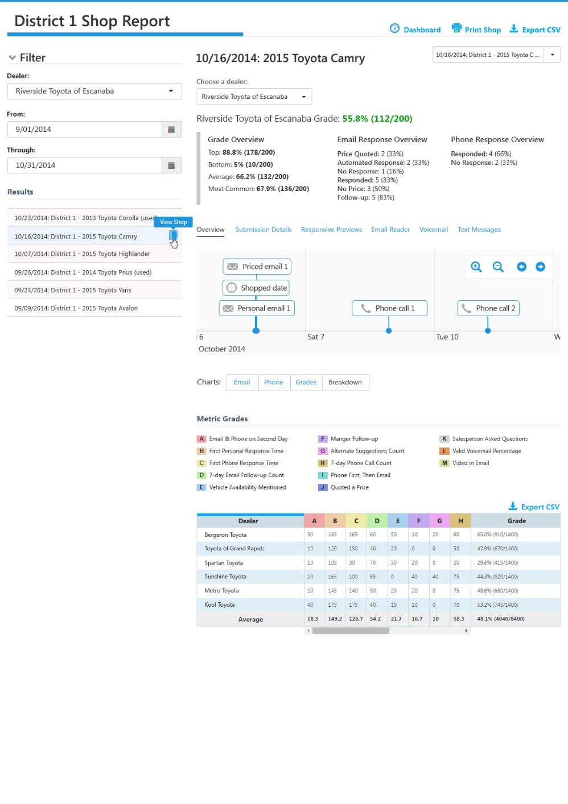
Reporting UI: Shop Report
Overview: Breakdown
Site Map: Searchable shop report history, with search restricted to district-level permissions
Highlights of selected shop
Timeline: Sequence of events plotted on a timeline to reveal the complete follow-up process followed by the dealer
Static Chart: Metric points and final grade totals by dealer for selected shop

Slide 38
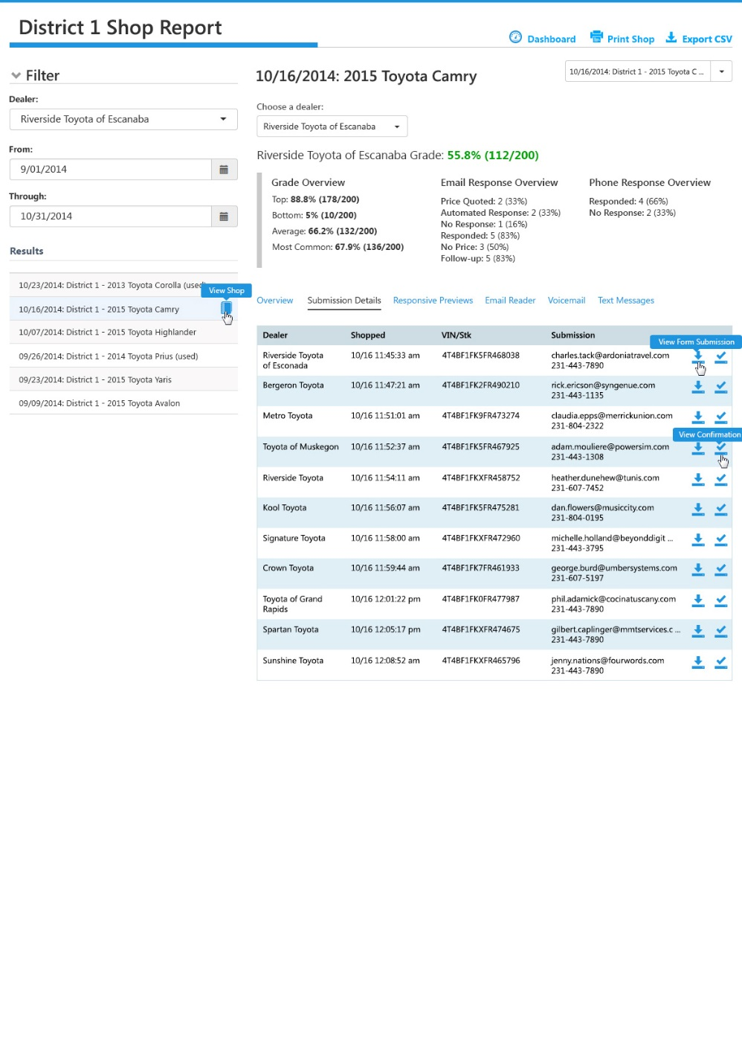
Reporting UI: Shop Report
Submission Details
Site Map: Searchable shop report history, with search restricted to district-level permissions
Highlights of selected shop
Target vehicle, tracking email, tracking phone, completed form screenshot, submission confirmation screenshot, details for dealers in the shop

Slide 39
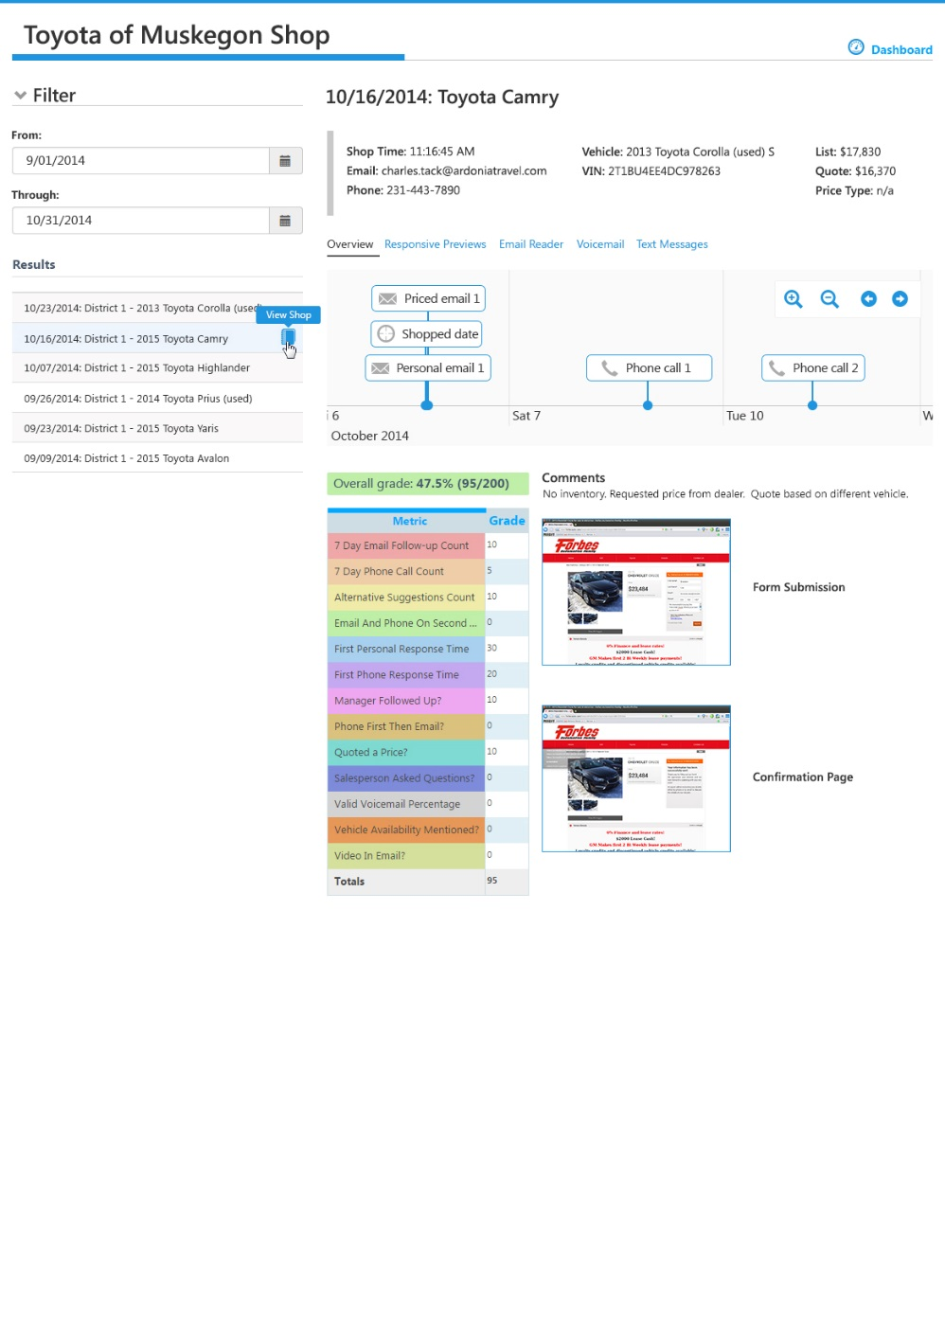
Reporting UI: Dealer Shop Report
Overview
Shop details
Site Map: Searchable shop report history
Timeline: Sequence of events plotted on a timeline to reveal the complete follow-up process followed by the dealer
Static Chart: Overall grade and per-metric grades for the selected shop
Screenshots of completed web form and confirmation of submission

Slide 40
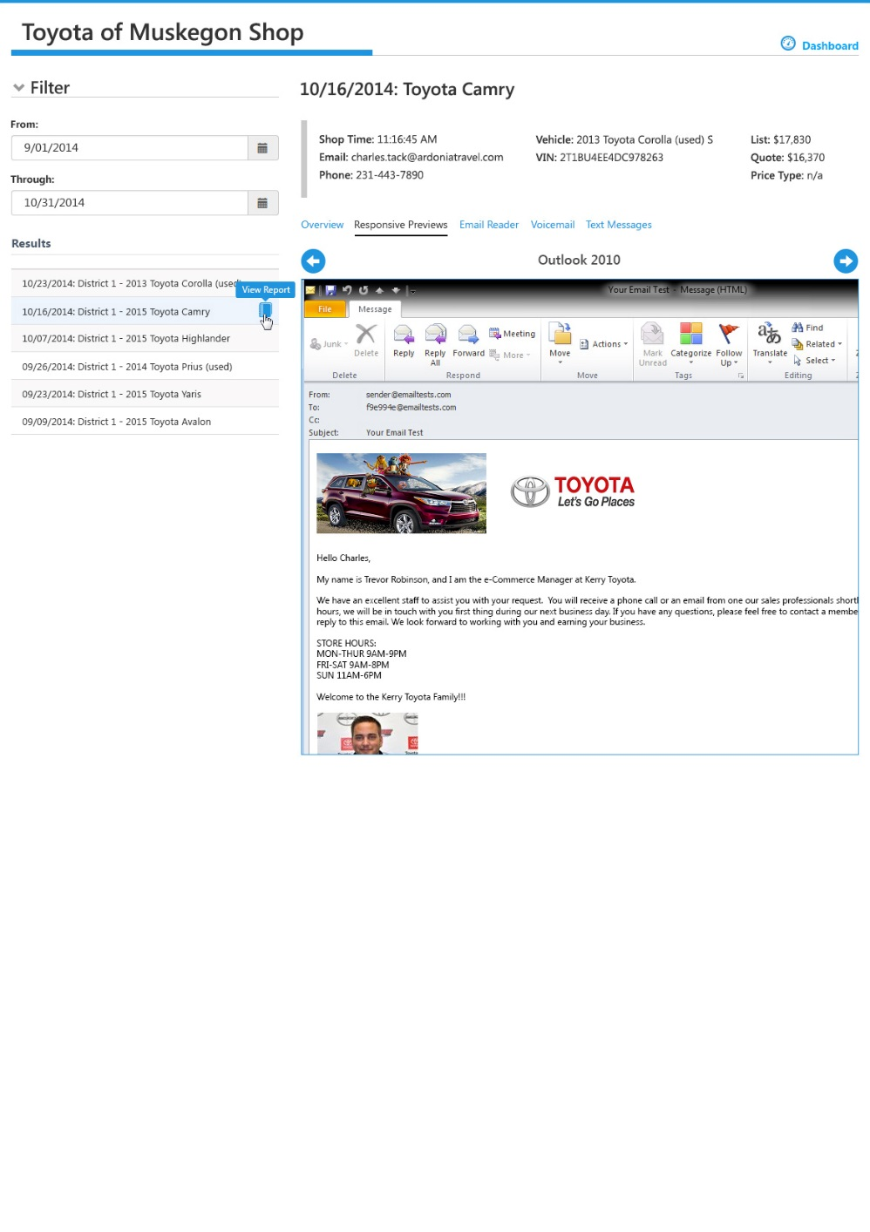
Reporting UI: Dealer Shop Report
Responsive Previews
Highlights of selected shop
Site Map: Searchable shop report history
Previews of rendered email in popular desktop, web, tablet, and mobile email clients

Slide 41
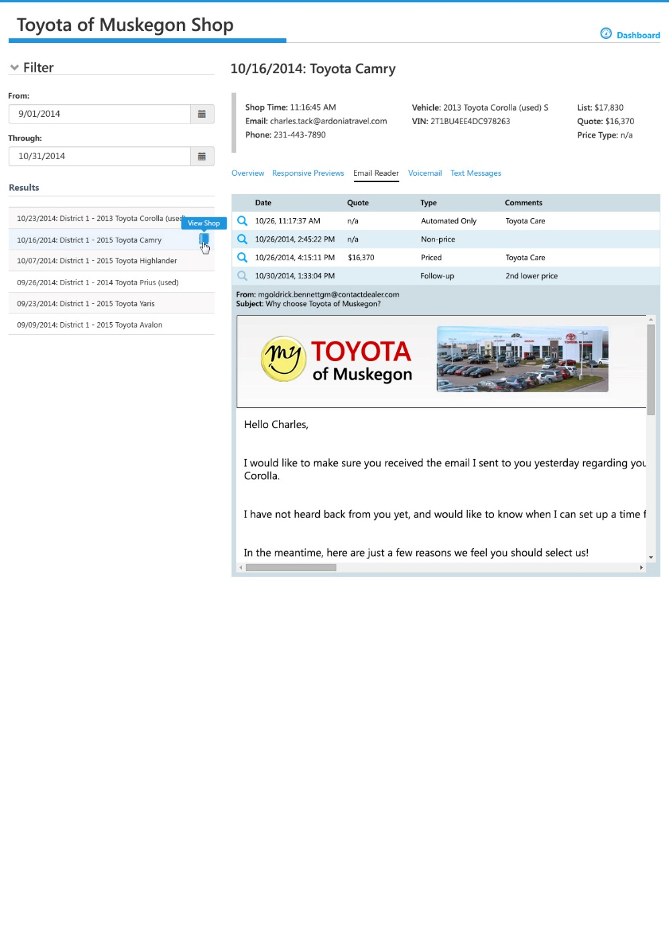
Reporting UI: Dealer Shop Report
Email Reader
Site Map: Searchable shop report history
Highlights of selected shop
List of email responses received
Preview of the selected email response

Slide 42
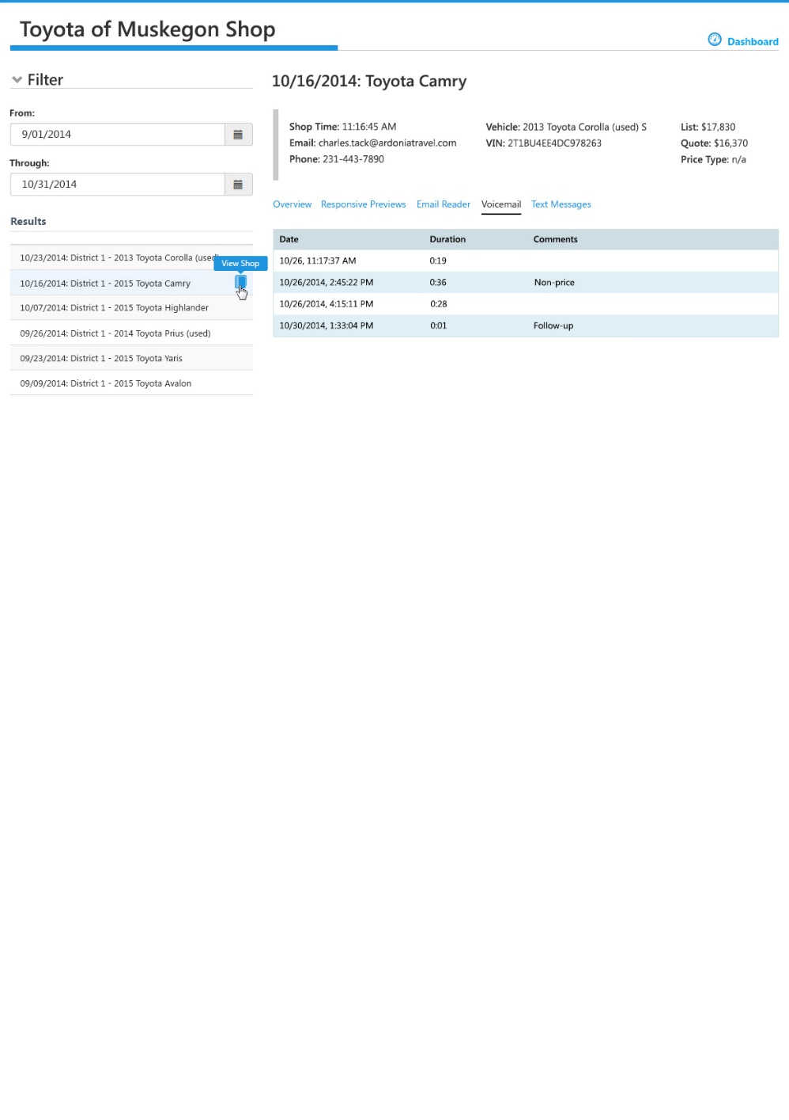
Reporting UI: Dealer Shop Report
Voicemail
Site Map: Searchable shop report history
Highlights of selected shop
List of voicemail messages received

Slide 43
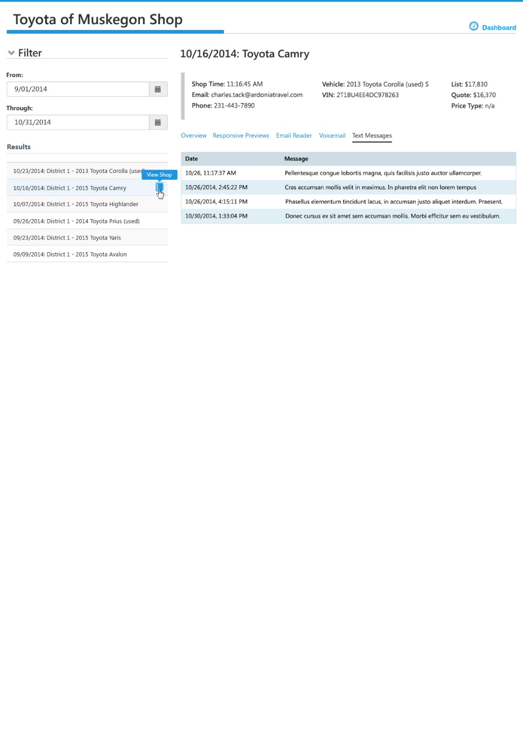
Reporting UI: Dealer Shop Report
Text Messages
Highlights of selected shop
Site Map: Searchable shop report history
List and details of text messages received

Slide 44
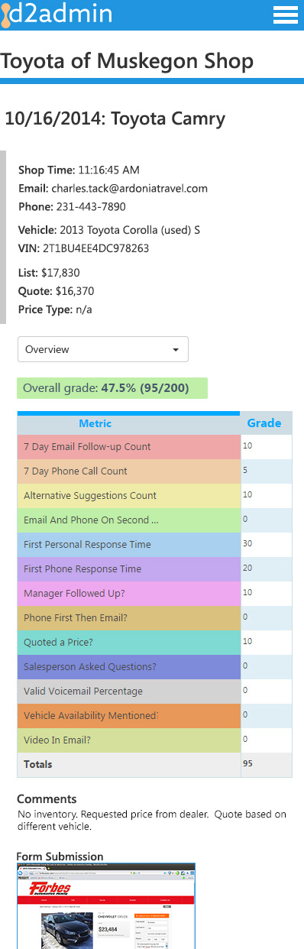
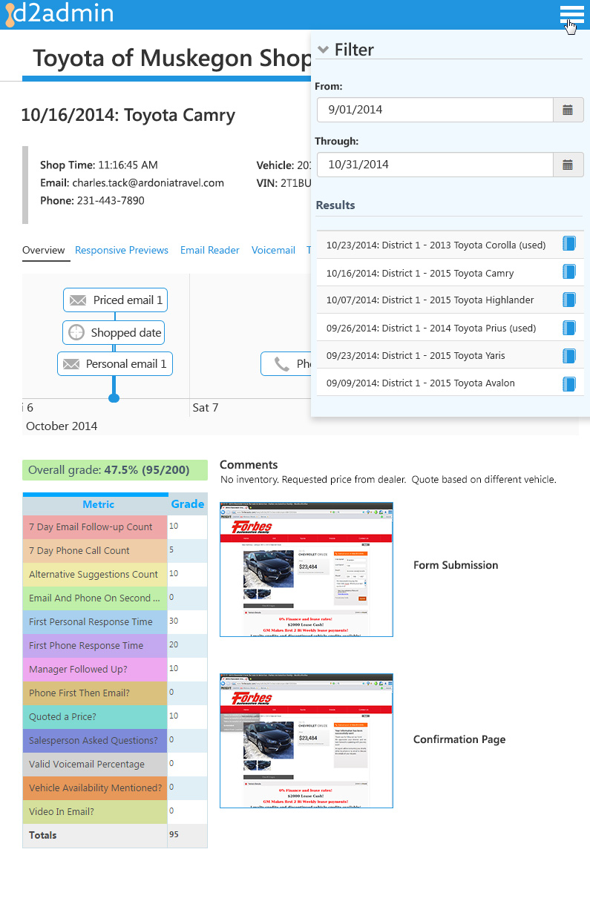
Reporting UI: Responsive
Mobile
Tablet

Slide 45
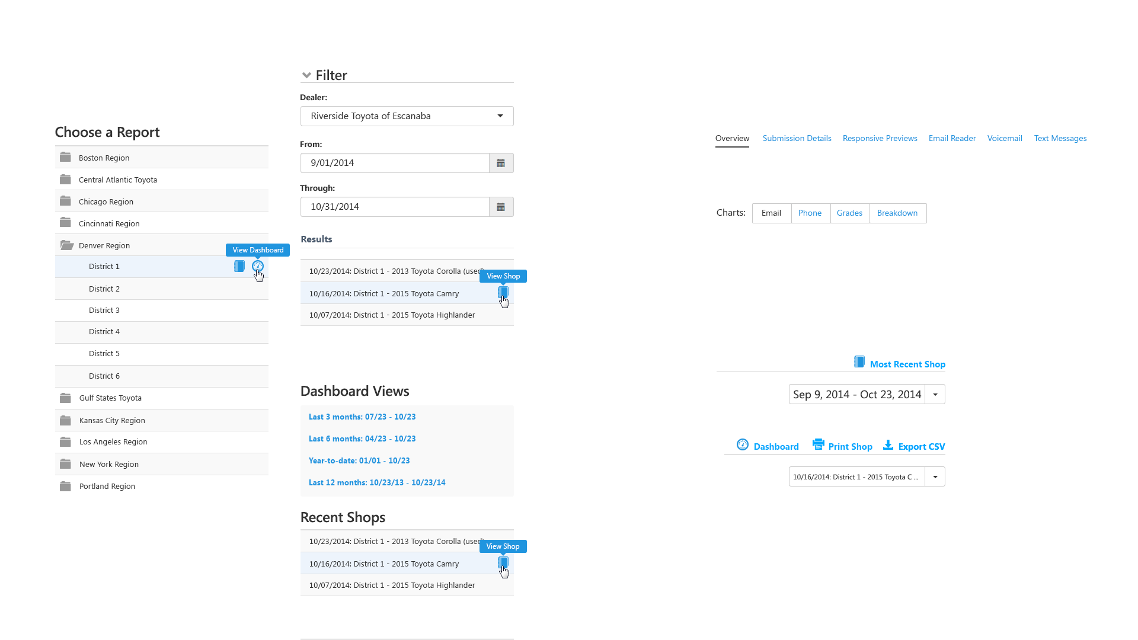
Reporting UI: Navigation
Sidebar Navigation
Dashboard & Shop Report
Main Navigation
Sub-navigation
Header Quick Links

Slide 46
Thank you!
We’re looking forward to a productive partnership.

